Slide 1
Unix Tutorial for
FreeSurfer Users
Allison Stevens Player

Slide 2
What is Unix/Linux?
An operating system
(like Windows and OS X)
Linux is the free, modifiable, and redistributable version of Unix
Why use it?

Slide 3
What is Unix/Linux?
An operating system
(like Windows and OS X)
Linux is the free, modifiable, and redistributable version of Unix
Why use it?
  power to write many scripts with many commands to work with lots of data

Slide 4
Getting Started
Communicate with operating system through a “shell” or terminal window.
For Linux:
Double click Terminal icon on Desktop
For Macs:
Double click on hard drive
Applications > Utilities > X11 (double click)

Slide 5

Warm Up
Type:
and hit enter.
date

Slide 6
Warm Up
Type:
and hit enter. Should see
date
Mon Apr 6 8:05:24 EDT 2009

Slide 7
Warm Up
Type:
and hit enter. Should see
Type:
and hit enter.
date
Mon Apr 6 8:05:24 EDT 2009
cal

Slide 8
Warm Up
Type:
and hit enter. Should see
Type:
and hit enter. Should see
date
Mon Apr 6 8:05:24 EDT 2009
cal
April 2009
Su Mo Tu We Th Fr Sa
1 2 3 4
5 6 7 8 9 10 11
12 13 14 15 16 17 18
19 20 21 22 23 24 25
26 27 28 29 30

Slide 9
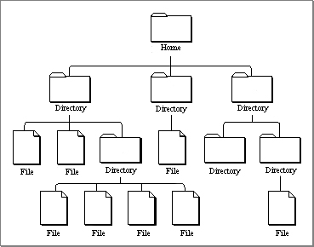
Directories
Unix uses a hierarchical file system
(think folders in Windows)

Slide 10
Directories
Unix uses a hierarchical file system
(think folders in Windows)
Home is like “My Computer”

Slide 11
Directories
Unix uses a hierarchical file system
(think folders in Windows)
Home is like “My Computer”
Like “My Documents”

Slide 12
Directories
Unix uses a hierarchical file system
(think folders in Windows)
Home is like “My Computer”
Like “My Documents”
Like “My Photos”

Slide 13
Directories
Unix uses a hierarchical file system
(think folders in Windows)
Home is like “My Computer”
Like “My Documents”
Like “My Photos”
picture.jpg

Slide 14
Location
Type:
and hit enter. Should see
shows “present working directory” or current location as a path
similar to:
/MyComputer/MyDocuments/MyPhotos
/home/nmrclass
pwd
OR
/Users/YourName

Slide 15
Opening a Directory
Not double clicking
Type command to “open”
Commands to open files will differ

Slide 16
Navigating Directories
“change directory”: move into a folder
“list”: see contents of directory
cd __
ls
ls __

Slide 17
Navigating Directories
“change directory”: move into a folder
“list”: see contents of directory
cd __
ls
ls __
Desktop matlab tmp TUTORIAL_DATA

Slide 18
Anatomy of a Command
command -option1 –option2 file
command - -help

Slide 19
Anatomy of a Command
command -option1 –option2 file
command - -help
Try:
ls --help

Slide 20
Directory Contents
List contents of directory you are in
  lists names of directories/files
ls
ls -a
ls -l
ls -lrt

Slide 21
Directory Contents
List contents of directory you are in
  lists names of directories/files
  lists hidden files too
ls
ls -a
ls -l
ls -lrt
.xdebug_tkmedit
.cshrc
.alias

Slide 22
Directory Contents
List contents of directory you are in
  lists names of directories/files
  lists hidden files too
  lists file details
drwxrwx---
ls
ls -a
ls -l
ls -lrt
user
group
others

Slide 23
Directory Contents
List contents of directory you are in
  lists names of directories/files
  lists hidden files too
  lists file details
  lists recent files last
ls
ls -a
ls -l
ls -lrt

Slide 24
Save Some Time
Filename Completion
hit Tab key
should see hit enter
History
hit key should see
ls Des
ls Desktop
ls Desktop

Slide 25
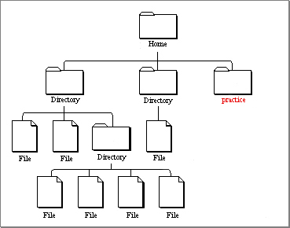
Changing Directories
makes a new directory “practice”
changes to directory “practice”
mkdir practice
ls -lrt
pwd
/home/nmrclass
should see
cd practice
pwd
should see
/home/nmrclass/practice
ls
should see
Nothing!

Slide 26
Changing Directories

Slide 27
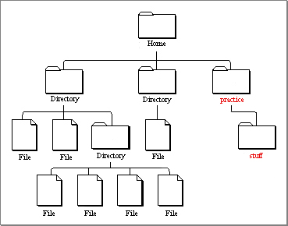
Changing Directories
mkdir stuff
makes folder “stuff” inside practice
ls
should see “stuff”

Slide 28
Using an Editor
If using a Mac:
Type: I could write a script in here.
File > Save (Buffer)
File > Exit emacs
should see “mynotes.txt”
emacs mynotes.txt
pico mynotes.txt
Ctrl-x if using pico
and then ‘Y’ and enter
ls

Slide 29
Using an Editor
If using a Mac:
Type: I could write a script in here.
File > Save (Buffer)
File > Exit emacs
should see “mynotes.txt”
gedit mynotes.txt
pico mynotes.txt
Ctrl-x if using pico
and then ‘Y’ and enter
ls

Slide 30
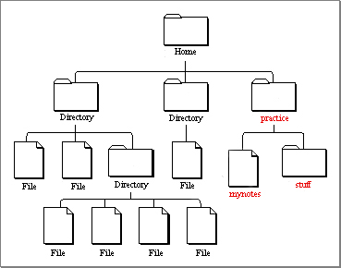
Using an Editor

Slide 31
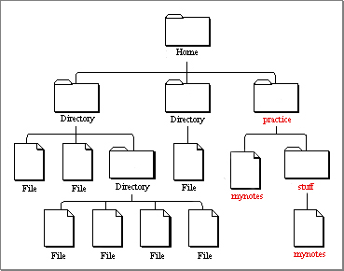
Copying files
cp
is the copy command
cp --help
learn all the options or “arguments”
cp mynotes.txt stuff
cd stuff
ls
more mynotes.txt

Slide 32
Copying files
cp
is the copy command
cp --help
learn all the options or “arguments”
cp mynotes.txt stuff
cd stuff
ls
less mynotes.txt

Slide 33
Changing Directories
shows one directory up
ls ..
can also do (but don’t):
cd ..
cd ../..
ls ../..
goes up two!
pwd
should see
/home/nmrclass/practice/stuff

Slide 34
Copying / Moving files
Could also use do:
cp mynotes.txt myothernotes.txt
mv myothernotes.txt hernotes.txt
mv hernotes.txt ..

Slide 35
Removing Files
pwd
should be in “stuff”
ls
rm mynotes.txt
ls

Slide 36
Review
no double clicking
mkdir
ls
cd
pwd
emacs, gedit, vi, pico
cp
rm

Slide 37
Using FreeSurfer
With FreeSurfer, certain variables must be set in order to use it correctly:
FREESURFER_HOME
SUBJECTS_DIR
tell Operating System where FreeSurfer is
tell FreeSurfer where data is

Slide 38
Required Variables
To go to location of your data:
$ means take the value of the variable
setenv SUBJECTS_DIR /path/to/data
cd $SUBJECTS_DIR

Slide 39
Required Variables
To go to location of your data:
$ means take the value of the variable
setenv SUBJECTS_DIR /path/to/data
cd $SUBJECTS_DIR
aka
cd /path/to/data

Slide 40
$
How ‘echo’ works:
To set a variable:
To check what a variable is set to:
echo Allison is cool.
setenv TEST_VARIABLE yourfirstname
echo $TEST_VARIABLE

Slide 41
Visualization Tools
For FreeSurfer visualization tools:
tkmedit subj001 T1.mgz -aux wm.mgz
tksurfer subj001 lh inflated
VisualizationTool subject data_file -aux other_data_file
VisualizationTool subject hemisphere data_file

Slide 42
More Help
http://surfer.nmr.mgh.harvard.edu/fswiki/FsTutorial/CommandLineNavigation
Links on Wiki under “Unix Tutorial”
Glossary of Unix commands

Slide 43
The End
Good Luck!

